Slide 1
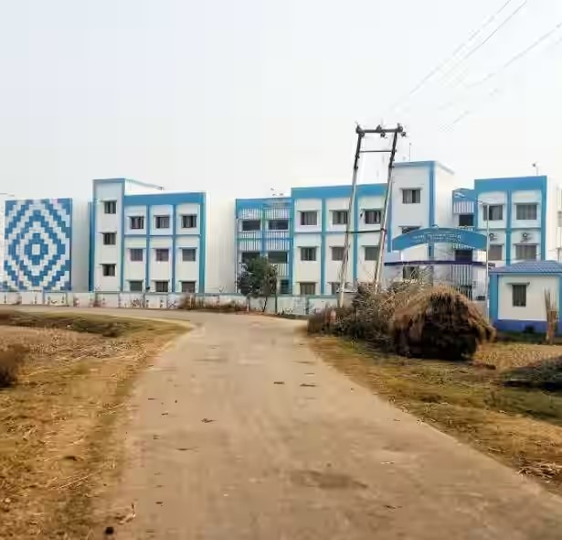
Electromagnetic Waves
Dr. Shaikh Safikul Alam
Assistant Professor of Physics
Government General Degree College, Chapra, Nadia

Slide 2
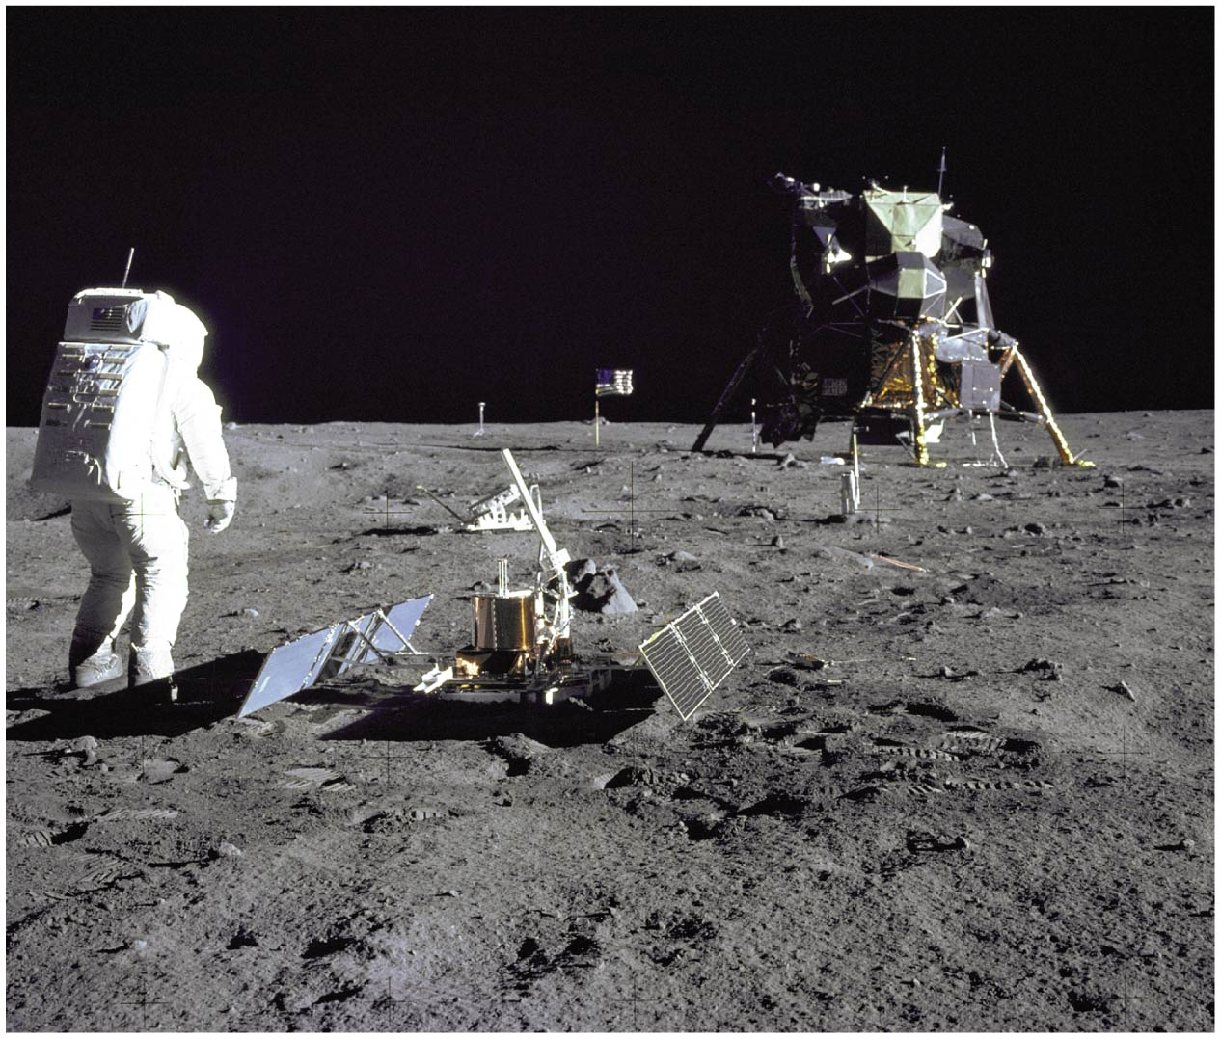
Electromagnetic Waves: Application

Slide 3
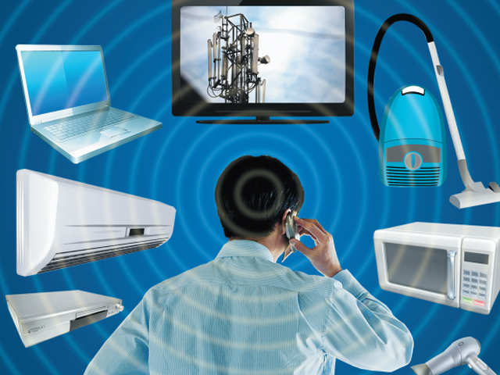
Electromagnetic Waves: Application

Slide 4
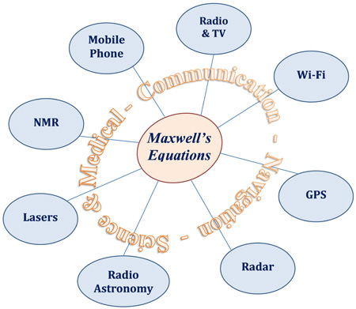
Electromagnetic Waves: Application

Slide 5
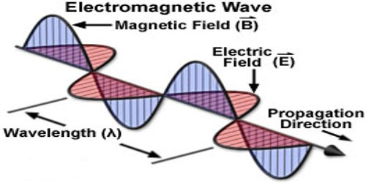
Electromagnetic Waves

Slide 6
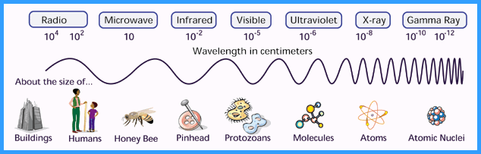
Electromagnetic Waves: Size

Slide 7
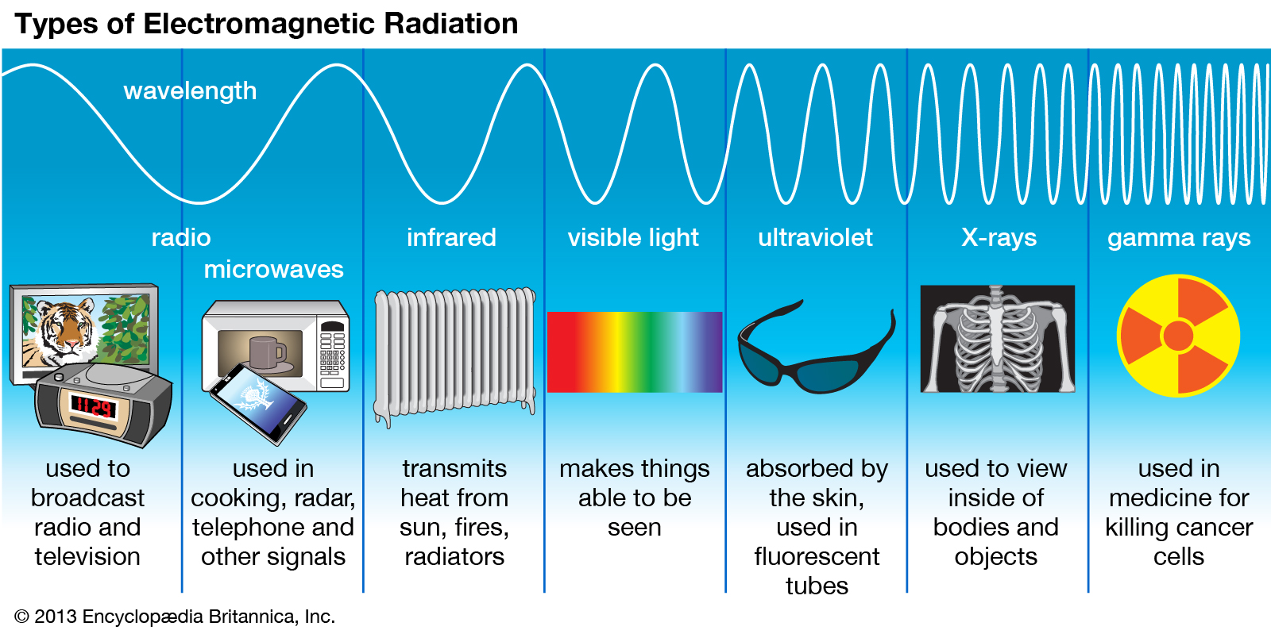
Electromagnetic Waves: Types

Slide 8
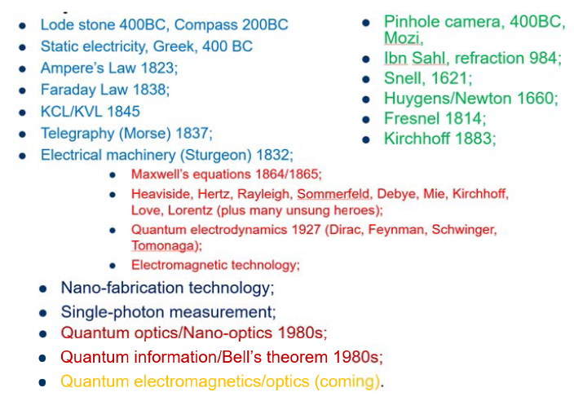
Electromagnetic Waves: History

Slide 9
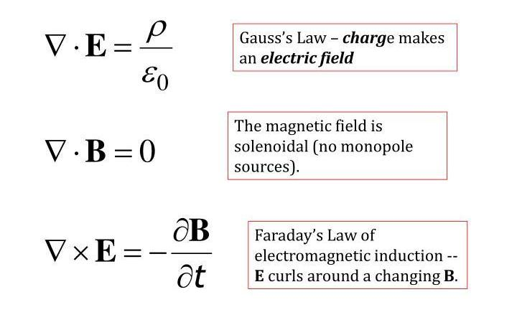

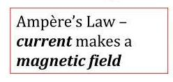
Maxwell Equations: Unmodified

Slide 10
Ampere’s Law
Electromagnetic Waves
B
I

Slide 11
Displacement Current
Electromagnetic Waves
I

Slide 12
Displacement Current
Electromagnetic Waves
Here there is a
varying electric field
but no current !
I

Slide 13
Displacement Current
Electromagnetic Waves
Stationary current I → electric
field changes with time
I
This displacement current
has to be added in the Ampere
law

Slide 14
Final form of the Ampere law
Electromagnetic Waves
integral form
differential form

Slide 15
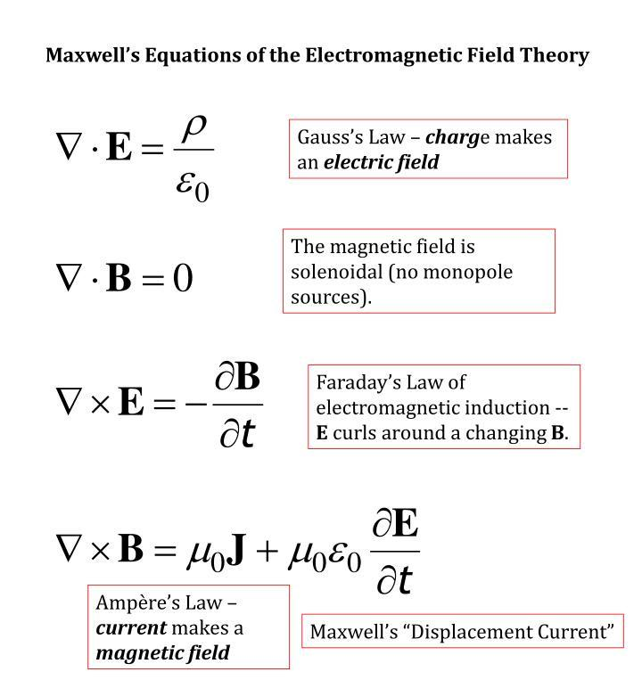
Maxwell Equations

Slide 16
Maxwell Equations in vacuum
Electromagnetic Waves
Integral form
Differential form

Slide 17
Electromagnetic Waves
General
Free space
Harmonic variation
Steady
Static

Slide 18


